Slide 1
Join at menti.com and use

Slide 2



Hugging Face x Transformers
Presented by
Bassel Al Omari and Matthew Bilopavlovic

Slide 3

Workshop Overview
Workshop Goals:
Gain theoretical insight into Transformers
Gain practical knowledge on training and fine tuning Transformers using Hugging Face 🤗
Join at menti.com and use
Notes:
Intermediate level refers to:
Solid programming experience with Python
Mid-level understanding of fundamentals of Deep Learning
Talking points:
Some theoretical insights into transformers, training and tuning transformers using hugging face
What knowledge is required to better understand this workshop (hugging face: some python experience, fundamentals of DL) - more intuitive than mathematical.
Mid level understanding of DL

Slide 4
Workshop Outline
Sequential Learning Background
Transformers
Overview
Applications
Components
Embeddings
Encoder Block
Decoder Block
Implementation with Hugging Face 🤗
Notes:
Talking points:
ML models that existed prior to transformers
Transformers
Advantages
Applications
Examples in success
Components - each part
HF platform and libraries
Demonstrate and fine tune transformers with a coding example

Slide 5
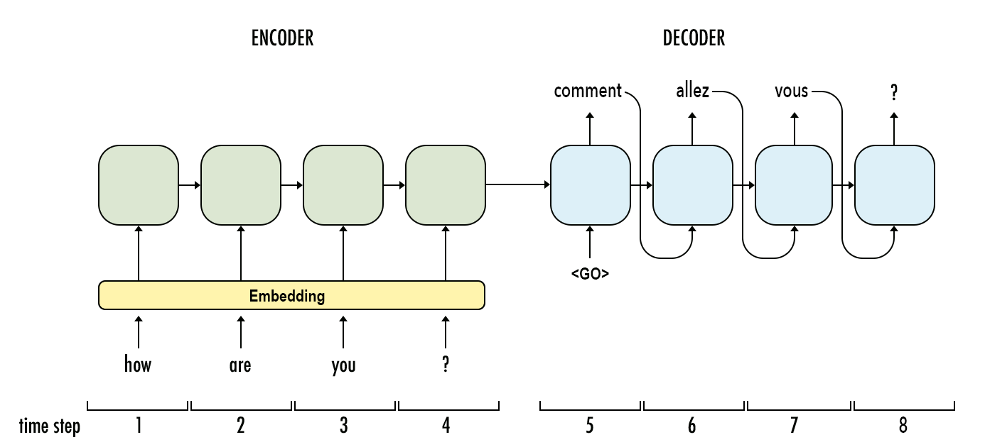
Pre-Transformers Era (Motivation)
NLP: Using ML to analyze and generate text (e.g. translation, question answering, etc.)
RNNs were primarily used for NLP because they:
Can handle variable length input (e.g. sentences of different lengths)
Can capture temporal dependencies
Major Bottlenecks:
Not parallelizable
Can’t handle long sequences
Notes:
Discuss use of RNNs and their major bottlenecks:
Information must be processed sequentially, not in parallel, meaning we aren’t taking full advantage of the GPUs capabilities. Hence training larger models requires more time.
Hard to deal with long input sequences. Information gets lost as you pass it through more and more units + issues with unstable gradients
Limits the performance of models for sequential tasks
Briefly define NLP with associated tasks (Translation, Question Answering, etc.), and mention sequences.
Talk about RNNs and their limitations
NLP definition: Uses statistical, ML, and deep learning models to give computers the ability to “understand” text in the same way humans can, including intent and sentiment.
RNN:
Definition + Structure Overview
Can handle inputs of variable lengths
Talking points in conversations
Uses sequential data
Time series, or sensor data
Captures data dependencies over time making it useful for tasks like text analysis or time series prediction
Limitations and Bottlenecks:
Sequential
Due to their nature (each step relying on all info from previous steps) RNNs are sequential, meaning every step must wait for each previous step to complete before moving on. This makes training on large data sets very time consuming
Large information
Since every step relies on complex info from all past steps, this dependence on previous inputs creates memory requirements that become exceedingly large as the size of data increases
Gradient problem??
Talking points:
NLP is a major subset of ML, understanding text using deep learning models
Examples in translating, question answering, email filters, predictive text, ChatGPT
RNNs were the go to model for NLP in the past
Good at processing sequential info, sentences
Can also handle variable length input
Sentences of different length
Bottlenecks
Sequential processing
Refer to diagram
Input must be processed step-by-step, using the output of the first step as part of the input for the next step
Larger models perform better but larger RNNs can take months to train
To compromise with practical training times, we build smaller, less accurate RNNs
Can’t handle long sequences
Processor will “forget” what happened 100 steps ago for example

Slide 6


Autobots Roll Out
In comes Transformers, introduced in “Attention Is All You Need”
Relies on Attention and MLPs
Advantages:
More Parallelized
= Faster to train large models
= Better model performance
Capable at capturing long range dependencies through Attention
Notes:
In comes Transformers
Architecture introduced in the “Attention is all you need” paper, and fascinatingly remains majorly unchanged since its inception.
Talking points:
Introduce “Attention is all you need” paper
Designed as architecture NLP problems (previous examples)
Relies on “self-attention” (more later on)
Major advantages:
Designed to handle inputs and train in parallel
Can train larger models with more parameters in same amount of time resulting in better performance
Through attention mechanism
More capable than RNNs at handling long range dependencies
Can remember data from time steps prior

Slide 7

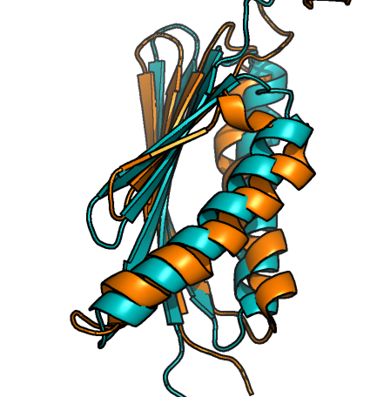

Applications and Success
First introduced to handle NLP related tasks
Later repurposed for others
Vision Transformers for Images
Decision Transformers for RL
Success cases
GPT
DALL·E 1
Alpha Fold 2
Notes:
Talk about its use in NLP, with text-generation models largely based around transformers (Chat-GPT).
Has replaced previously used architectures for other sequential tasks, such as Protein Folding. Success of Alpha Fold 2 (which had “solved protein folding”) is largely dependent on the switch to Transformers.
The original DALLE 1 (image generation) used a variant of Transformers. Note that the second generation, DALLE 2 utilizes diffusion models (to be introduced in the next workshop).
Talking points:
First introduced for NLP tasks
Seen success in the GPT models, text generation, question answering, SnapChat AI
GPT: Generate Pre-Trained Transformers
Can be used for other tasks
Vision transformers (image inputs)
Decision transformers (reinforcement learning)
DALL E 2 uses diffusion models (in another workshop we’re hosting)
Transformers are not a one size fits all
Mention the meaning behind each photo

Slide 8
Transformer Architecture
Decoder
Encoder
Embedding
Notes:
Mention that we’ll be going over the original architecture of Transformers that was introduced in AIAYN, and how it has largely remained unchanged since.
We’re gonna be looking at the architecture from the perspective of a Translation task.
Transformer can be split into 3 main components: the Embeddings, the Encoder and the Decoder.
Talking points:
We will be going over original transformer architecture introduced in original “AIAYN.” paper
Architecture has remained largely unchanged
Architecture can be split into 3 main components
[have animations for each part come up when referencing]
Embeddings
Encoder
Decoder
Will look at how a transformer can be used for translation
How a sentence in english is processed and translated into french

Slide 9

The Encoder-Decoder Model
English
The goose attacked the student yesterday
Yesterday…
Arabic
الأمس هاجمت الوزة الطالب
Encoder
Decoder
Input
Hidden Representation
Output
Extract meaning from input
Use meaning to perform task and produce output
Notes:
Take a step back (abstract the transformer) and look at the general Encoder-Decoder structure.
This same concept of a encoder-decoder was present when using RNNs when doing translation.
It is a combination of models, first (the encoder) takes in the input and extracts the most important information from it or its meaning (in some form, which is just a vector [set of numbers] that houses that meaning). The decoder then takes that information and uses it to perform the task and produce the output.
Example is of translation (trying to translate a sentence from English to Arabic).
Machine Learning model takes in the input (a given sentence in English).
The Encoder extracts the meaning from the sentence, i.e. there’s some goose, there’s some student, the day before, the goose absolutely trampled the student. The Decoder then produces that same information but in Arabic.
Alternative example can be found in image generation models, where the encoder takes in the input sentence and understands what the user is trying to draw and then the decoder uses that information to generate the images.
Another is a question/answer model, where the encoder takes in the question and understands what the user is trying to know, and then the decoder uses that information to produce an answer.
The models in question are much more complicated and intricate than that, but this is the basic abstraction that underlies the functions of each component.
We’ll be focusing on the translation example in this workshop and seeing how an input sentence travels through the transformer which then produces an output.
Talking points:
Take a step back and take a look at general encoder and decoder structure
Used in ML and present in RNNs
Combo of 2 models of any type (CNN, RNN, etc.)
Encoder model
Takes input and extracts most relevant info and meaning of input
Decoder model
Uses encoder info and meaning to produce output
Eng sentence is passed to encoder model (“goose attacks student yesterday”)
Meaning is extracted from sentence
[Meaning is stored in numeric values]
Past tense “yesterday”
Decoder produces equivalent output

Slide 10
Transformer Architecture
Decoder
Encoder
Embedding
Notes:
Talking points:
Will see how a transformer handles tasks like translation
Input: Sentence in one language (chunk of tokens)
Sentence divided into different words (tokens)
Output: Sentence in another specified language
Starting off input words are passed into embeddings

Slide 11
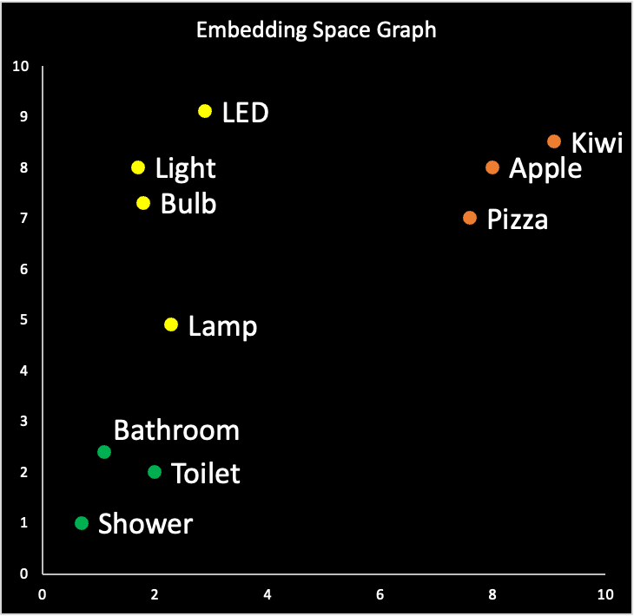
Input Embedding
Extracts the information about the individual words
Input Embedding maps words to vectors
Similar Words = Closer Coordinates
Input Embeddings
Alex plays football
Notes:
Talk about why we convert words to embeddings (models don’t understand characters and better understand vectors).
Talk about what the embeddings space looks like: multi dimensional world where each word is a coordinate and words that have related meanings are closer together.
Can pass all words in the sentence in here at once (fully parallel)
Mention that embeddings are frozen and found on the internet
Talking points:
ML models can’t understand what a word or characters are
Prefer inputs as numbers (vectors)
Converts each word to a vector/set of numbers
This vector houses some meaning behind the word
Coordinates in a space
Words that correspond to vectors with similar coords, house similar meanings
Refer to visual for an example
Bathroom and toilet

Slide 12
Positional Encoding
Embeds information about the position of the word in a sentence
Necessary to establish sequence in the parallel input
White dog and black cat
Words can have a different meaning depending on the position
“Dear John, …” vs “Ask my dear friend John”
Vector for each word, with information on meaning and position in sentence
1 1 2 3 4 5
Sentence
Notes:
Talk about the importance of positional encoding: the meaning of a word changes depending on where it lies in the sentence. (Example: the word “dear” in “dear john,” vs “I saw my dear friend john”)
ESTABLISH SEQUENCE:
Since we pass all the words in a sentence in parallel, we need to also include information about its position in the sentence (to know what words come before and after others).
In the example, you see that we number each of the words in this input sentence. The numbers help us associate each adjective with the pet (since white comes right before dog, and black comes right before cat, we know that the dog is white and the cat is black and not the other way around).
Positional encoding isn’t as simple as adding a number to indicate its position.
MEANING:
Also, words can have different meanings depending on the position. This is captured by the positional encoding which differentiates the word’s meaning according to its position in the sentence.
For examples: The word “dear” when appearing the beginning of the sentence (such as “Dear John”) is used to address someone, but when used later in the sentence (such as “my dear friend John”), is used as an adjective to describe someone close.
Talking points:
The vectors previously generated hold info about the meaning of each word individually
Positional encoders take input vectors and determines position in sentence and adds to the vector info about word position
Words have different meanings at different parts of the sentence
Dear at the beginning of a sentence vs in the middle of a sentence
Introduced for transformers
In RNNs you don’t need to know the order of the input because that’s inherit to how RNNs work, every step relies on every previous step
In transformers, data is handled in a parallel manner, each word is handled separately, order needs to be tracked
PEs apply a function to each token vector that transforms the vector so that it also now stores positional information about the token (first, third, 16th, etc.)
Reference example

Slide 13
Transformer Architecture
Decoder
Encoder
Embedding
Notes:
Talking points:
Recap
Taken input sentence
Split sentence into individual words
Using embeddings, we define what each word means
Using PE, we stamp each word with its position in the sentence

Slide 14
Encoder Block
Adds contextual information for each word
Employs Self-Attention in the Multi-headed Attention Block
Embeds “attention scores” corresponding to strength of relationship between two words
Computes values using Scaled Dot-Product Attention
black dogs and red cats
black ➡ black dogs and red cats
dogs ➡ black dogs and red cats
and ➡ black dogs and red cats
red ➡ black dogs and red cats
cats ➡ black dogs and red cats
Notes:
Encoder block now needs to add information about how each word relates to the other words in the sentence.
Using this technique introduced in the Attention is All You Need Paper (it existed, they slightly modified it by adding scaling) called Scaled Dot-Product Attention, we can calculate attention scores.
For each word in the sentence you have an attention score corresponding to each other word in the sentence. The higher this score is, the stronger the relationship is.
In the example on the right, we see adjectives give their associated nouns high attention scores and the rest low attention scores.
These scores get embedded into the input vectors, and what gets outputted from the encoder block is now a vector for each word with information on both its meaning and how it fits in the context of the sentence.
For those interested, more mathematical descriptions of the Multi-headed attention block are included in the bonus slides at the end of the presentation.
Once again, fully parallelized and makes it more efficient to extract information than RNNs
Talking points:
We now want to understand how each word relates to each other
Encoder block does that using attention
For every word in the sentence encoder assigns attention score to every other, relating the two words
Refer to example

Slide 15
Transformer Architecture
Decoder
Encoder
Embedding
Notes:
At this point (after we’re done with the encoder), we’ve created a vector for each word in the sentence that contains information about the meaning of the word itself and with respect to the words around it.
Next comes the decoder block which uses this information

Slide 16
Decoder Block
“pomme”
Output
Output Classifier
Combine information about word relationships in input and previous output
Encoded Input
“I ate the apple”
Calculate Attention Score between previous output words
Output so far
“j'ai mangé la ”
Notes:
Is it parallel?
During training, you can opt to have it parallel or not.
Sequential would involve passing the output back as input
Parallel involves “Teacher Forcing” (method using in training most LLMs), where the true value of the output is passed in as input to the decoder block.
During inference, definitely not parallel.

Slide 17
Decoder Block
Classifier
Linear layer followed by Softmax
Produces probabilities of what the next output word should be
Output is passed back in as input and process is repeated until output limit is reached or Stop Token is produced
English: “My name is Jack”
French: “Je …”
95% | 3% | 1% | 1%
m’appelle | nom | prenom | Other words
Notes:
The final section of the decoder block is the classifier.
Information previously calculated determines what next word is
Calculate a probability for each next word
For example:
Say we’re translating the sentence: “My name is Jack”, and we’ve previously outputted “Je …”, the output of the classifier ideally would be
90% “m’appelle”
8% “nom”
2 % “prenom”
The rest are zeros
To make outputs less predictable, we don’t always take the word with the highest probability, but instead sample from this distribution
Temperature controls the probability of picking a word from the distribution
Is it parallel?
During training, you can opt to have it parallel or not.
Sequential would involve passing the output back as input
Parallel involves “Teacher Forcing” (method using in training most LLMs), where the true value of the output is passed in as input to the decoder block.
During inference, definitely not parallel.

Slide 18
Teacher Forcing
Input: My name is Bassel Target: Je m’appelle Bassel
Without Teacher Forcing
Do all predictions in sequence using previous output as decoder input
With Teacher Forcing
Do all predictions in parallel using target as decoder input
Decoder Input | Output
 | Mon
Mon | Mon nom
Mon nom | Mon nom Bassel
Decoder Input | Output
 | Mon
Je | Je prenom
Je m’appelle | Je m’appelle Bassel
Notes:
The final section of the decoder block is the classifier.
Information previously calculated determines what next word is
Calculate a probability for each next word
For example:
Say we’re translating the sentence: “My name is Jack”, and we’ve previously outputted “Je …”, the output of the classifier ideally would be
90% “m’appelle”
8% “nom”
2 % “prenom”
The rest are zeros
To make outputs less predictable, we don’t always take the word with the highest probability, but instead sample from this distribution
Temperature controls the probability of picking a word from the distribution
Is it parallel?
During training, you can opt to have it parallel or not.
Sequential would involve passing the output back as input
Parallel involves “Teacher Forcing” (method using in training most LLMs), where the true value of the output is passed in as input to the decoder block.
During inference, definitely not parallel.

Slide 19
Architecture Recap
Decoder
Encoder
Embedding
Notes:
Mention that we’ll be going over the original architecture of Transformers that was introduced in AIAYN, and how it has largely remained unchanged since.
We’re gonna be looking at the architecture from the perspective of a Translation task.
Transformer can be split into 3 main components: the Embeddings, the Encoder and the Decoder.
Talking points:
We will be going over original transformer architecture introduced in original “AIAYN.” paper
Architecture has remained largely unchanged
Architecture can be split into 3 main components
[have animations for each part come up when referencing]
Embeddings
Encoder
Decoder
Will look at how a transformer can be used for translation
How a sentence in english is processed and translated into french

Slide 20
Menti Competition
Join at menti.com and use

Slide 21
Question: Advantages of Transformers over RNNs?
Simpler design
Perform better on smaller datasets
More parallelized and efficient to train
Correct Answer: Option C
Notes:
Is it parallel?
During training, you can opt to have it parallel or not.
Sequential would involve passing the output back as input
Parallel involves “Teacher Forcing” (method using in training most LLMs), where the true value of the output is passed in as input to the decoder block.
During inference, definitely not parallel.

Slide 22
True/False
Positional Encoders are also used in RNNs
False - RNNs process the words in order, so they implicitly know the word-order

Slide 23
What is the Attention Score?
Measures the similarity between the meaning of two words in a sentence
Measures the strength of the relationship between two words in a sentence
Rating for a Charlie Puth song
Correct Answer: Option B
Notes:
Is it parallel?
During training, you can opt to have it parallel or not.
Sequential would involve passing the output back as input
Parallel involves “Teacher Forcing” (method using in training most LLMs), where the true value of the output is passed in as input to the decoder block.
During inference, definitely not parallel.

Slide 24
What is the Transformer’s final output activation function?
Softmax
ReLU
tanh
Correct Answer: Option A
Notes:
Is it parallel?
During training, you can opt to have it parallel or not.
Sequential would involve passing the output back as input
Parallel involves “Teacher Forcing” (method using in training most LLMs), where the true value of the output is passed in as input to the decoder block.
During inference, definitely not parallel.

Slide 25
What is Teacher Forcing?
Training a transformer without the attention mechanism
Feeding the target output (instead of the previous outputs) as input to the decoder
Training Transformer by Knowledge Distillation (using a teacher model)
Correct Answer: Option B
Notes:
Is it parallel?
During training, you can opt to have it parallel or not.
Sequential would involve passing the output back as input
Parallel involves “Teacher Forcing” (method using in training most LLMs), where the true value of the output is passed in as input to the decoder block.
During inference, definitely not parallel.

Slide 26
What loss function is used for a Text-Generation Transformer?
Distance between the output word and the true output, when converted as vectors in the embedding space
Cross-Entropy loss between the softmax layer output and the true output
Something Else
Trick Question: All are true. Option B is used for overwhelming majority of cases. Other training methods include Reinforcement Learning from Human Feedback (used to actively fine-tine ChatGPT)

Slide 27

Hugging Face

Slide 28
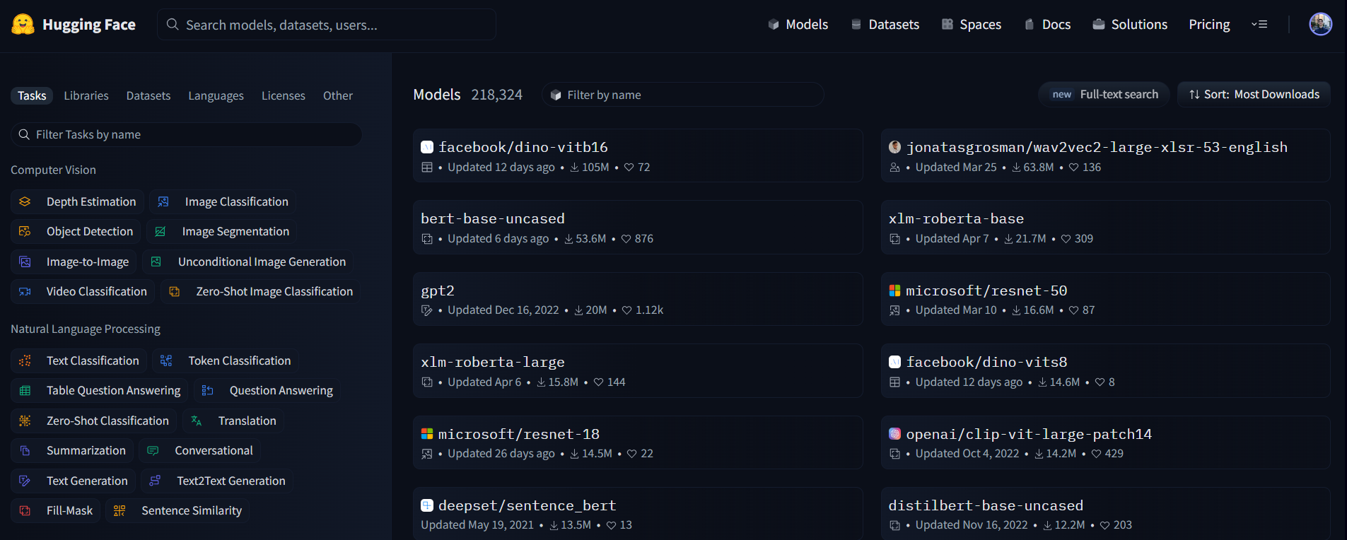
Thousands of Open-Source Models

Slide 29
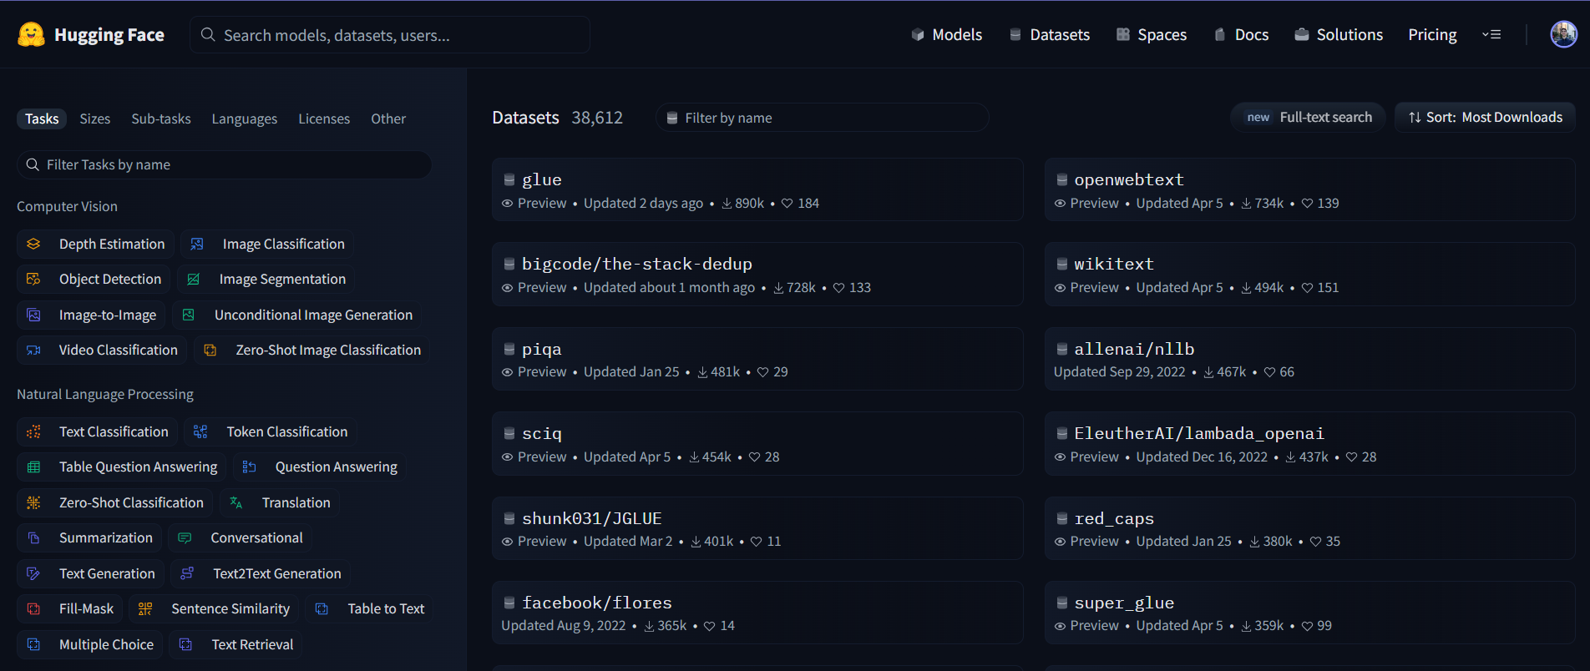
Thousands of Datasets

Slide 30

Open-Source ML Libraries

Slide 31
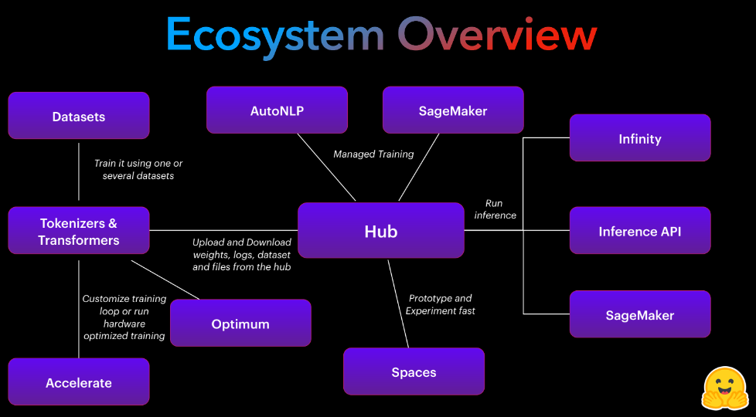

Slide 32
Hugging Face Demo
shorturl.at/EL238

Slide 33
Where to go from here
Self-Attention in more detail: Mathematical overview of how attention scores are calculated
Falcon-40B Guide: Current best performing LLM (+ open sourced)
Transformer Agents with Hugging Face: Infinity stones for your LLM
Hugging Face Spaces: Host interactive demos for your ML models
Notes:
The final section of the decoder block is the classifier.
Information previously calculated determines what next word is
Calculate a probability for each next word
For example:
Say we’re translating the sentence: “My name is Jack”, and we’ve previously outputted “Je …”, the output of the classifier ideally would be
90% “m’appelle”
8% “nom”
2 % “prenom”
The rest are zeros
To make outputs less predictable, we don’t always take the word with the highest probability, but instead sample from this distribution
Temperature controls the probability of picking a word from the distribution
Is it parallel?
During training, you can opt to have it parallel or not.
Sequential would involve passing the output back as input
Parallel involves “Teacher Forcing” (method using in training most LLMs), where the true value of the output is passed in as input to the decoder block.
During inference, definitely not parallel.

Slide 34
Thank you for your attention

